Slide 1

MCSD 1043 RESEARCH DESIGN AND ANALYSIS IN DATA SCIENCE
PROJECT PROPOSAL PRESENTATION
Predicting traffic congestion in Malaysia using machine learning algorithms
Lu Ruiqi/ MCS231028
25 JULY 2024

Slide 2

Contents
1.Introction
2.Literature Review
3.Methodology
4.Initial Results

Slide 3
1.Introduction

Slide 4
Traffic congestion is a global issue affecting both urban and rural areas, including Malaysia. Inefficient traffic control and high vehicle numbers lead to delays, increased fuel consumption, rising pollution, and reduced economic efficiency. Major cities like Kuala Lumpur, Penang, and Johor Bahru experience frequent traffic jams, but rural areas are also impacted. Effective traffic management must consider local conditions and patterns. This research aims to predict traffic congestion on Malaysian highways using various data sources and modeling techniques. By analyzing traffic patterns and factors like weather and roadworks, we can identify trends and provide actionable recommendations for traffic management. The study aims to influence national and regional transportation policies, improving traffic flow, reducing environmental impact, and fostering economic growth. This data-driven approach offers significant benefits for urban and regional planning.

Slide 5
Background Information
Main Goals
• Traffic congestion is a significant issue in urban and rural Malaysia.
• Affects daily commute times, economic activities, and environmental quality.
• Importance of understanding and managing congestion for better urban planning.
• Collect and analyze traffic data.
• Identify major contributors to traffic congestion.
• Develop predictive models for traffic congestion.
• Provide actionable insights for traffic management authorities.

Slide 6
Problem Statement
Traffic congestion is a wide-range problem that is influenced by many factors such as traffic volume, road conditions, weather, public events among othersAnalyzing and attacking the problem is a complex task. Traditional methods of attacking the problem have fallen short in the hope of managing traffic volume and giving a cleaner experience to the commuter.

Slide 7
Research Questions
1. What are the major contributors that cause traffic congestion across different parts of Malaysia?
2. How can we model these factors using predictive models that can forecast traffic congestion levels?
3. How do the traffic patterns and congestion factors that contribute to traffic conditions vary for different regions within Malaysia?
4. What actionable insights and recommendations can be made based on the analysis and model predictions to effectively control and manage traffic congestion?

Slide 8
Scope of the Study
Geographical Coverage:
Time Frame:
Urban centers, smaller cities, and rural areas across Malaysia.
Evaluation of daily, weekly, and monthly traffic data.
1
3
Analytical Techniques：
The methodology includes collection of data related to traffic, weather, and GIS modules/roadworks and through the application of machine learning algorithms to evaluate regional traffic patterns, traffic congestion started and to recommend routing choices particularly when there is severe congestion.
2
4
Data Sources:
Traffic reports, weather data, roadworks, public events.
Open data from government portals and other sources.

Slide 9
2.Literature Review

Slide 10
Traffic congestion is a prevalent problem in urban areas worldwide, leading to economic losses, environmental pollution, and a decline in quality of life. Malaysia, a country undergoing rapid urban development and escalating private vehicle ownership, is subject to grim traffic congestion, especially in major cities. The aim of this chapter is to study the relevant literature regarding traffic congestion: discuss about causes, effects, and prior research that have developed machine learning algorithms to aid both the prediction and amelioration of the issue. The literature review highlights the complexity of traffic congestion and the potential of machine learning algorithms to address it. The findings will guide the methodology in the next chapter, which will detail data acquisition, preprocessing, and analysis methods. This summary captures the key points from Chapter 2 and provides a foundation for understanding the context and significance of the research on predicting traffic congestion in Malaysia.

Slide 11
3. Methodology

Slide 12
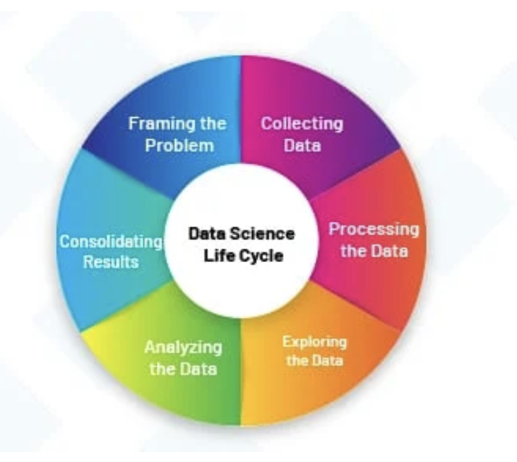
Data Science Project Life Cycle
1. Problem Definition: Clearly state the problem you want to solve, for instance, the research problem investigated in the study is: predicting traffic jam in Malaysia using machine learning algorithms.
2. Data Collection: Aggregate data needed from multiple resources, such as traffic reports, weather conditions, road constructions, and public events.
3. Data Preprocessing: Clean the collected data, by imputing any missing or null values as well converting different time formats of the data and incorporating new derived features.
4. Model Development: Processing and training of machine learning models to gain insight and learn the complex patterns in the dataset.
5. Deployment and Monitoring: Final stage that is implementing the best performing model and monitoring its behavior in a production environment.
6. Reporting and Visualization: Interpret model results with visualizations and reports with practical interpretations of the model predictions, uncertainty and stability of the predictions.

Slide 13
Data Sources and Collection Methods
Data Pre-processing
• Steps:
• Cleaning: Removing duplicates, handling missing values.
• Transformation: Normalizing data, converting formats.
• Feature Engineering: Creating new features based on domain knowledge.
Data Sources:
• Traffic Data
• Weather Data
• Public Transport Ridership Data
• Vehicle Registration Data
Collection Methods:
• APIs
• Open data portals
• Web scraping
03
Text Here
Easy to change colors.

Slide 14
4. Initial Results

Slide 15
Initial Results - Primary Data
Visualizations: Line graphs, scatter plots, bar charts.
Descriptive Statistics: Mean, median, standard deviation.
Initial Insights: Peak traffic periods, weather impact on traffic.
Feature Engineering: Time-based and weather-based features.

Slide 16

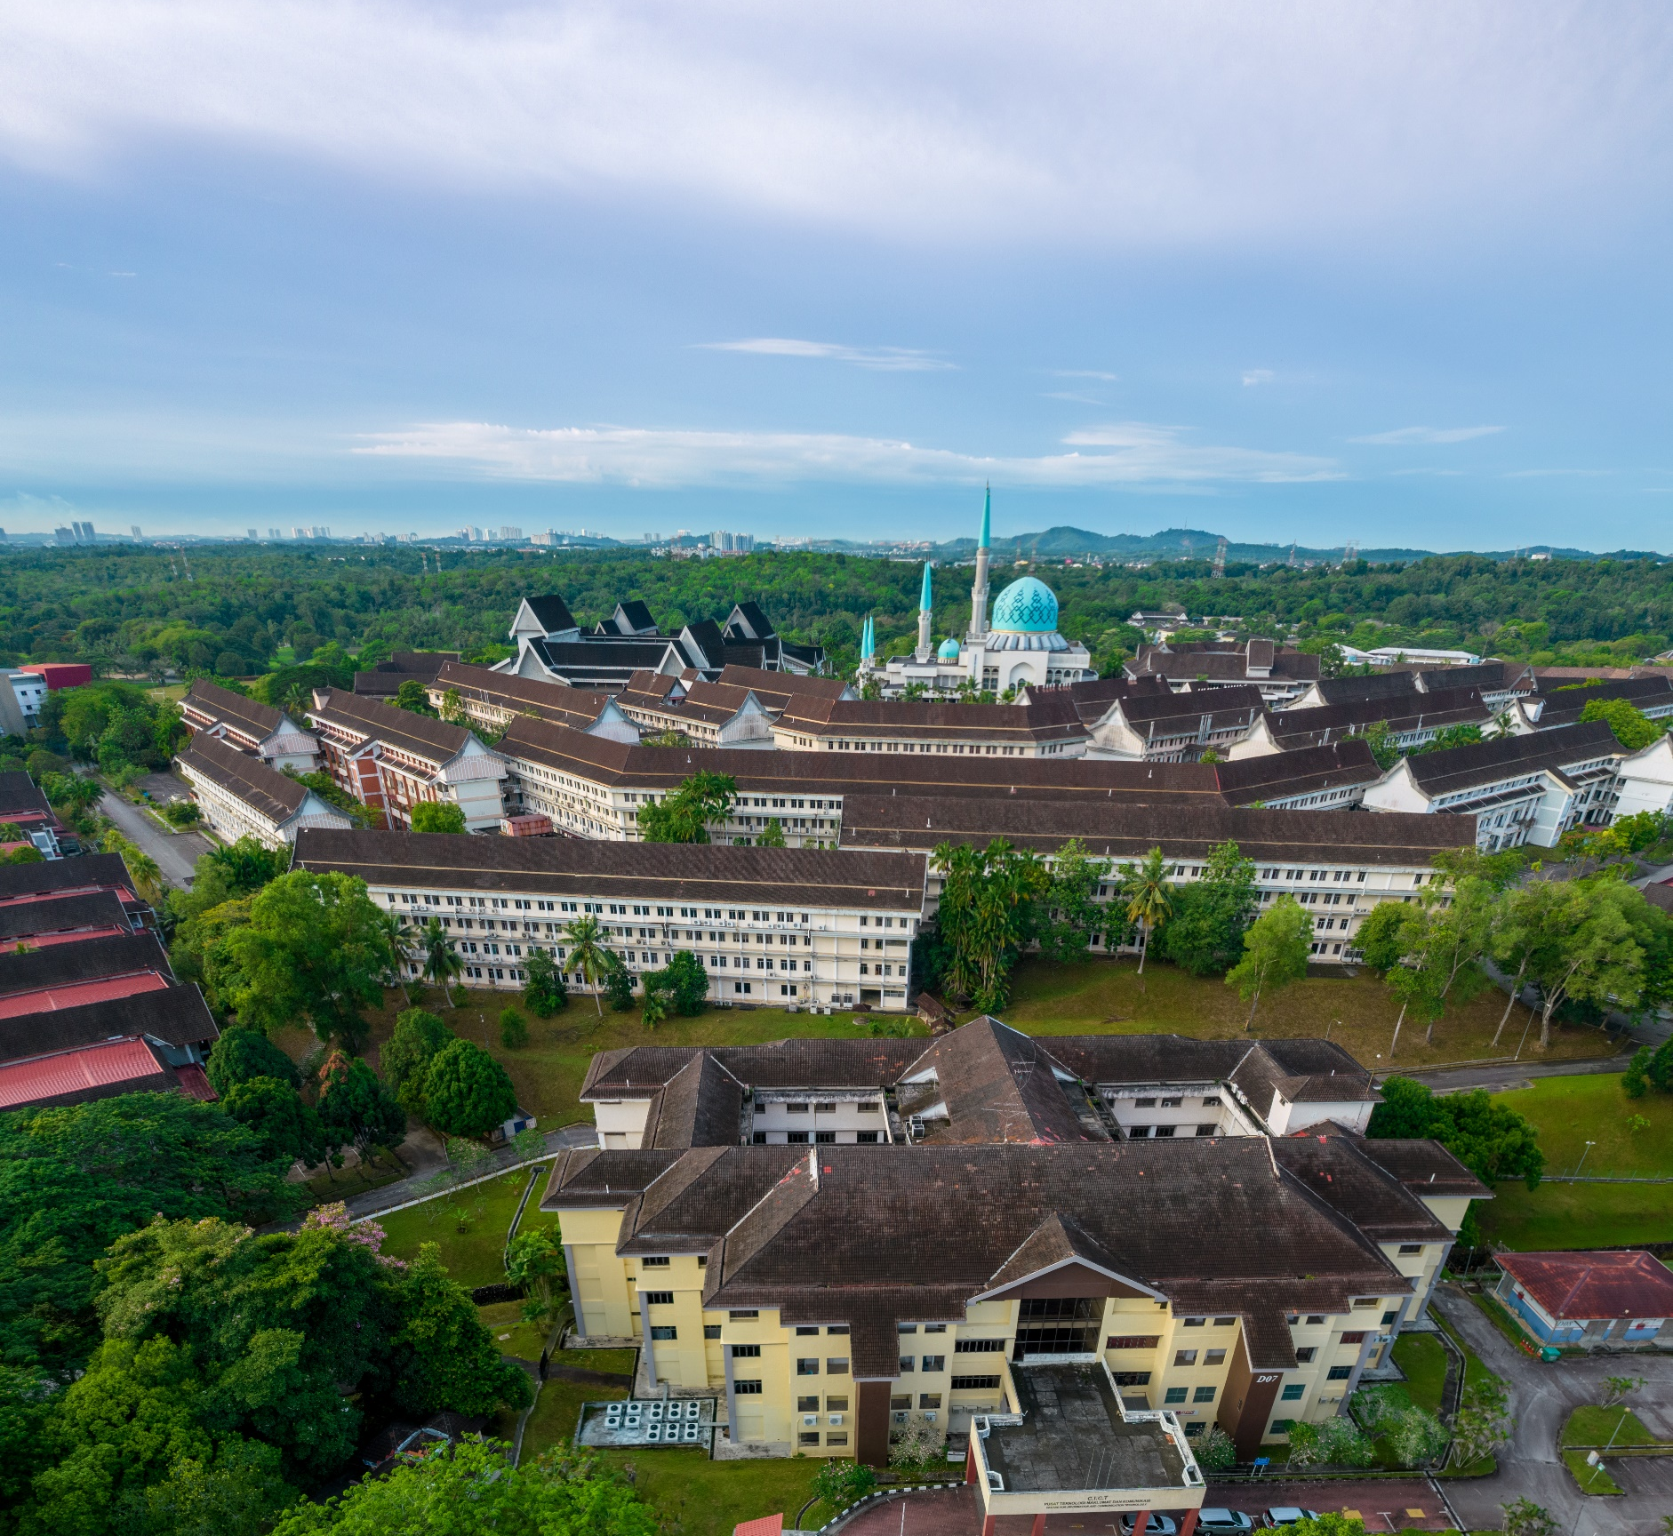
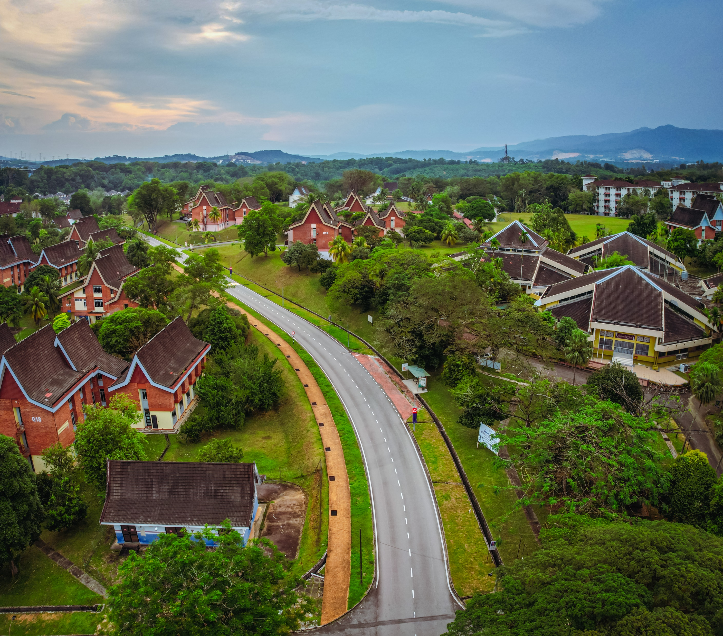
Machine Learning
01
02
03
Model Selection:
Initial Findings:
Next Steps:
• Linear Regression, Decision Trees.
• Metrics: Mean Absolute Error (MAE), R-squared.
• Weather conditions and ridership significantly influence traffic volumes.
• Decision Trees perform better in capturing non-linear relationships.
• Hyperparameter tuning, incorporating additional features.

Slide 17
Summary
01
Effective use of machine learning to predict and manage traffic congestion.
02
Benefits to economic efficiency, environmental quality, and commuter satisfaction.
03
Importance of data-driven decision-making in urban planning.

Slide 18


THANK YOU
utmofficial
univteknologimalaysia
utm.my

